Slide 1
DOUBLY CURVED
SURFACES MODELING
FONTYS ACADEMY of ARCHITECTURE, TILBURG
Giulio Piacentino 2008
mail@giuliopiacentino.com

Slide 2
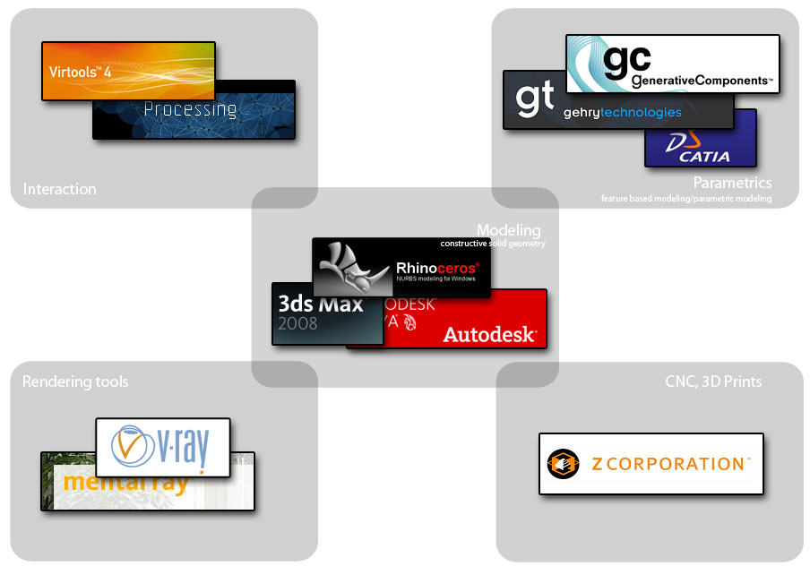
PROJECT WORKFLOW
software used in current architectural discourse
MESH,
NURBS
POINTS, LINES, MESH
NURBS, MESH, SUBDIVS
MESH
MESH

Slide 3
WORKSHOP SCHEDULE
Nov 28
Dec 5
morning
morning
2D/3D
interface
patterns
curves
Complex surfaces
manipulate
solids
afternoon
afternoon
surfaces
construction
your project
help with choices
Intro,
paper model
Solids
modeling

Slide 4
Before we start:
feel free to stop me whenever you feel it is necessary or you don’t have everything clear!

Slide 5
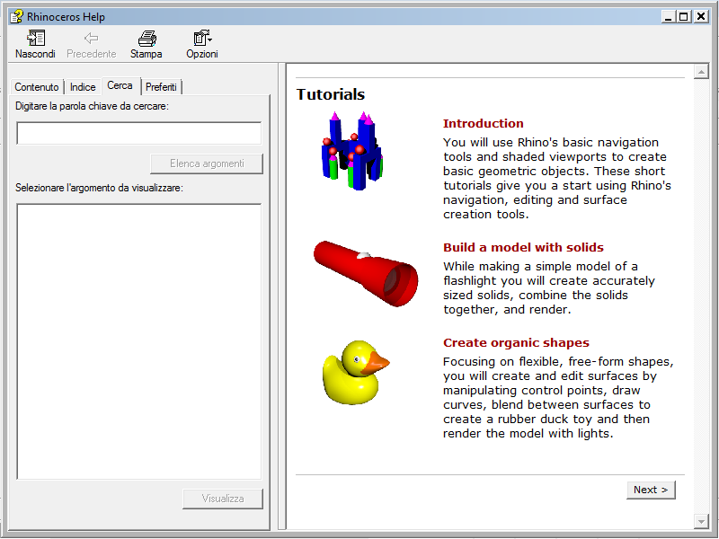
THE RHINO INTRO

Slide 6
INTERFACE

Slide 7
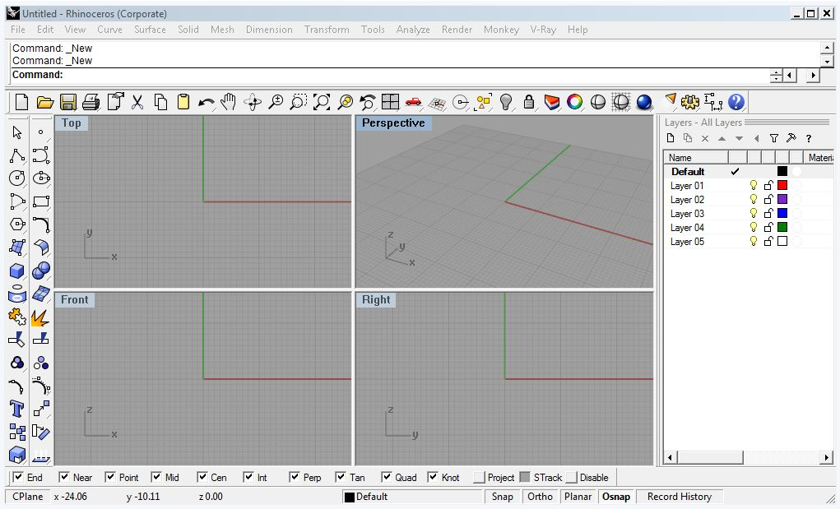
INTERFACE
You can give instructions to Rhino by: menu items, command line and buttons.

Slide 8
For architectural practice:
use the meter modelspace
with small objects (recommanded),
or the centimeter modelspace with large objs.
Thirdly, mm (large).

Slide 9
INTERFACE
Construction planes (Cplane) are view-dependent (one in each window)
GLOBAL: symbols
LOCAL: X is RED and Y is GREEN Z through right-hand rule

Slide 10
SHORTCUTS
F1 (help)
Alt
-temporarily disable oSnap
-copy object instead of drag
F2 (commandHistory )
F3 (properties)
F6 (show camera)
Ctrl
-elevator mode
F8 (ortho)
F10 (pointsOn)
Shift
-temporarily toggle ortho
F11 (pointsOff)

Slide 11
GEOMETRICAL
BASICS

Slide 12
POINTS AND LINES
points and straight lines are the easiest set of objects in rhino
points can be grouped into pointClouds
lines can be joined into polylines. polylines are still MANY lines.

Slide 13
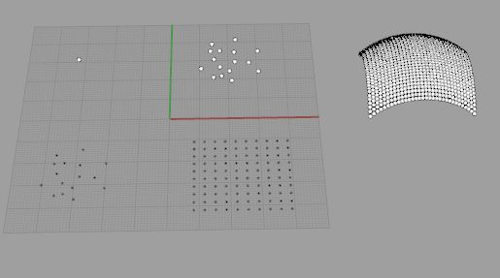
POINTS AND LINES
point
points
drapePt
pointCloud
pointGrid

Slide 14
POINTS
0,0,0
0,0,10 0,0,20 0,0,30
0,0,0
r0,0,10 r0,0,10 r0,0,10
When you give coordinates , you can add an r to make the coordinate relative to the last given point.

Slide 15
CURVES
curves are renders of mathematical equations
curves in rhino are NURBS curves (Non-Uniform Rational B-Splines)
they have: a degree
they have: control points
they have: weights

Slide 16
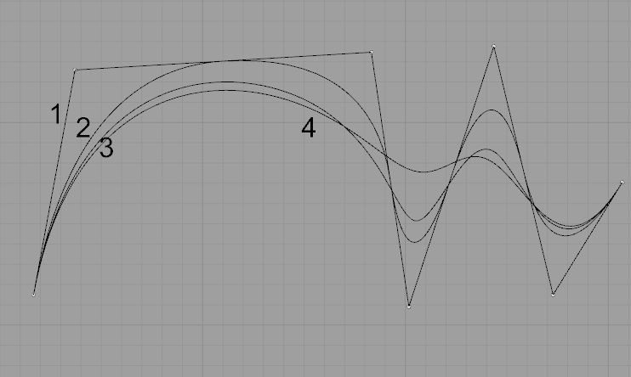
CURVES
draw 3 or more curves with the same control points and different degrees.

Slide 17
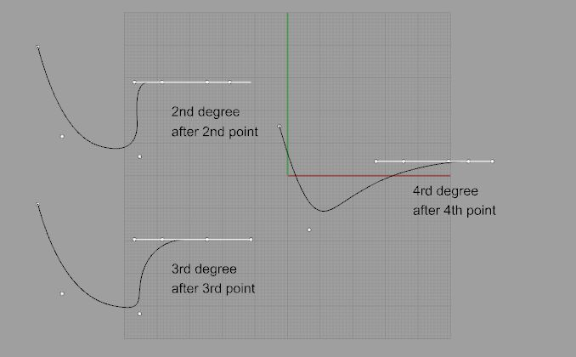
CURVES
you get a straight line after… as many points edit point in a row as the degree of the curve.

Slide 18
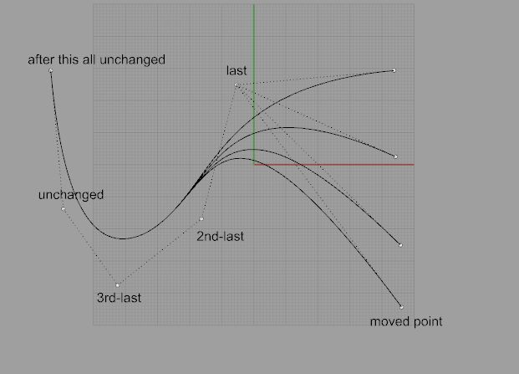
CURVES
If we use any third degree NURBS curve,
and we modify any set of points,
the first curve segment to coincide again will be the one between the 2nd-last and the 3rd last modified point. After that, all will coincide again.

Slide 19
CURVES
If the curve has kinks, you can explode it into smaller parts
Otherwise you can divide it with split

Slide 20
CURVES
You can join them back together, with Join, but they will be transformed into polyLines and polyCurves (depending on the degree).
Try the command Properties to inspect the outcome.

Slide 21
CURVES
In some situations we may need to rebuild these polycurves, so that they can return to be a single entity.
A similar command to try is also rebuildCrvNonUniform.
Both these commands reconstruct selected curves or surfaces to a specified degree and with a specified number of control points.

Slide 22
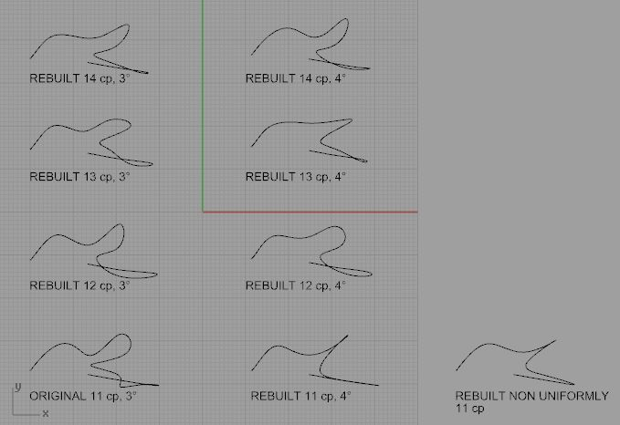
CURVES
Not always it is easy to rebuild a curve to something similar, if we don’t add many more points.

Slide 23
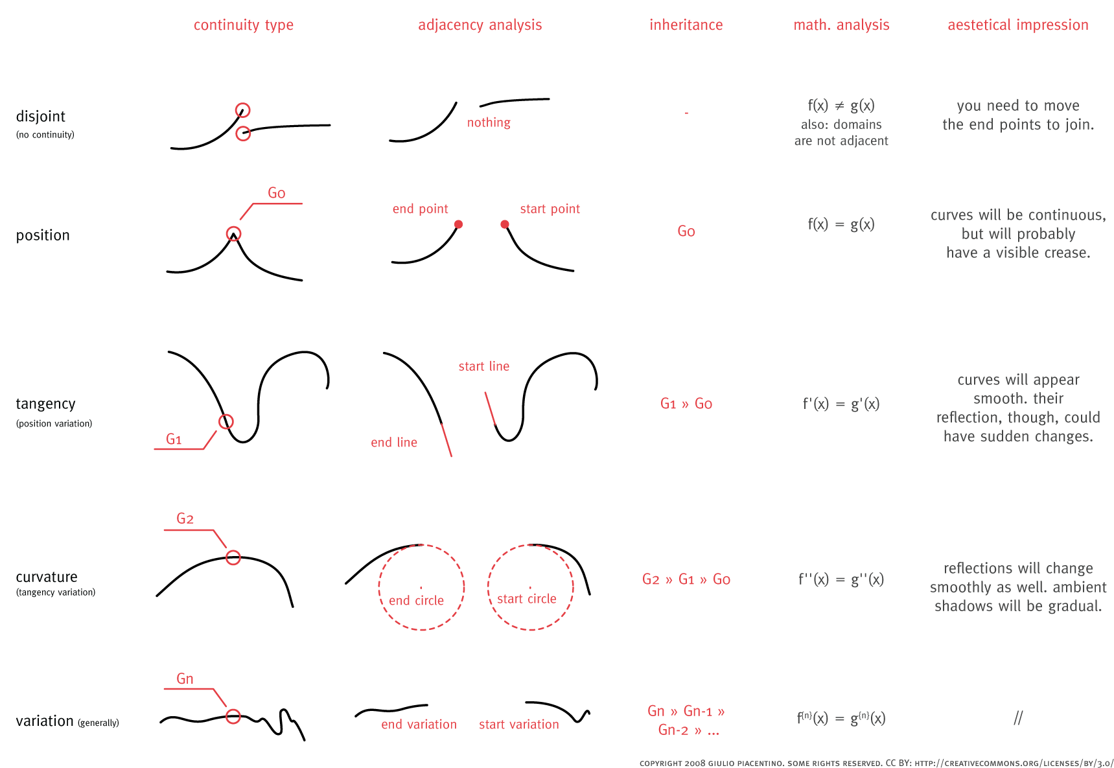
IN A INSTANT

Slide 24
SURFACES

Slide 25
SURFACES
besides points and curves,
NURBS surfaces are the basics of geometry in Rhino and can be used to draw both flat things and objects
edge
isocurve
An isoparametric curve (isocurve) is a curve of constant u- or v-value on a surface. Rhino uses isocurves and surface edge curves to visualize the shape of a NURBS surface. By default isocurves are drawn at knot locations. If the surface is a single knot-span surface like a simple rectangular plane, isocurves are drawn also in the middle of the surface.

Slide 26
SURFACES
u
v
NURBS are inherently rectangular (U / V)
also surfaces can be rebuilt.

Slide 27
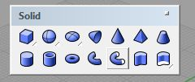
SURFACES
Platonic solids and regular surfaces
default.solid toolbar
some of these commands create singular surfaces

Slide 28
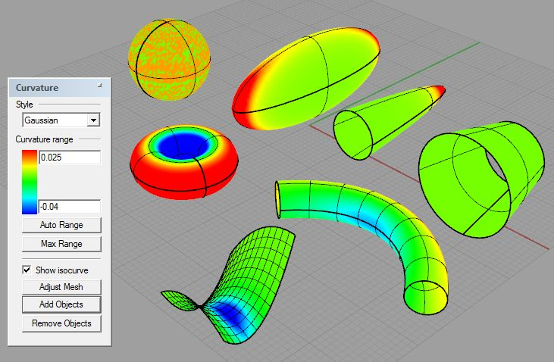
SURFACES
curvature analysis of some singular NURBS surfaces

Slide 29
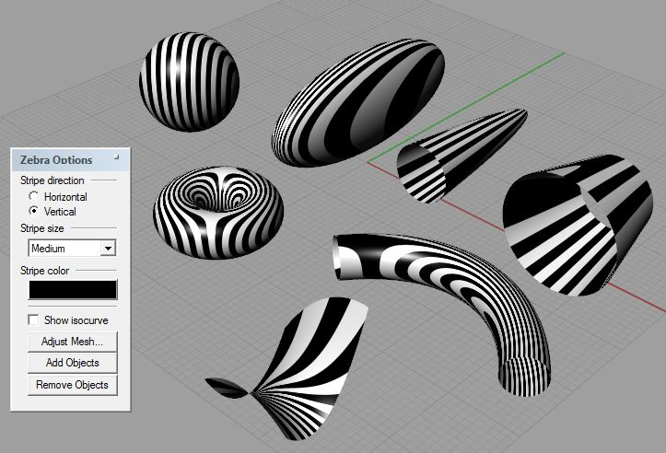
SURFACES
zebra (to visualize position, tangency and curvature continuity)
write help for more information about it

Slide 30
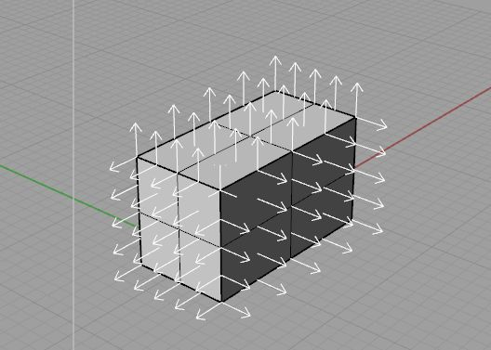
SURFACES
dir (to visualize and change direction of orientation), with crvs & srfs
solids always have the normal toward the interior.
flip directly turns the direction of crvs and srfs.

Slide 31
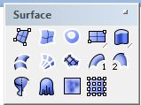
SURFACES
10 basic methods of surface creation in Rhino
SrfPt
corner
points
ExtrudeCrv
one curve
and (one
size)*
Revolve
profile (crv) axis (2 pts)
Sweep1
rail (crv) profile (crv)
Loft
sections (curves)
EdgeSrf
2,3,4 edge
curves
BlendSrf
two
surfaces
RailRevolve
rail (curve
profile ) (crv axis)
Sweep2
rail 1 (crv) rail 2 (crv) profile (crv)
NetworkSrf
4 or more crvs
* More options of input are available

Slide 32
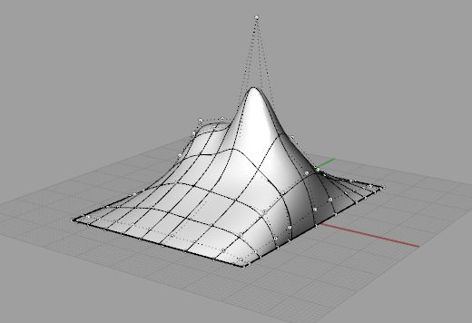
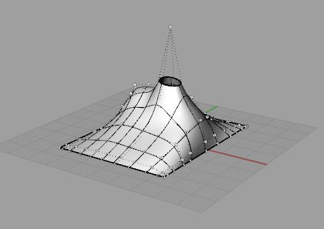
SURFACES
trim will cut the surface. But the control points remain.

Slide 33
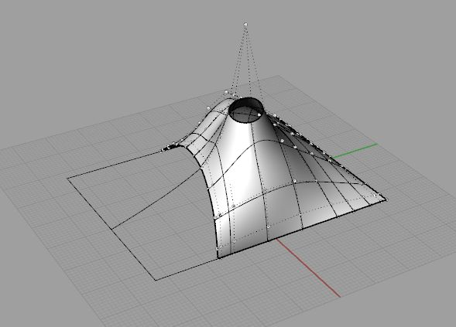
SURFACES
in some exceptional cases, we can use the command shrinkTrimmedSrf.
splitting along an isocurve will also automatically shrink the surface.

Slide 34
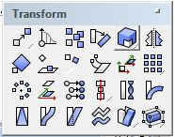
TRANSFORM TOOLS
If you are familiar with any modeling software, you’ll find out that
you can guess what each of these buttons will do.

Slide 35
VARIOUS OTHERS
in the next exercises you might find also the following other commands
useful:
divide a curve
offset a curve
project (parallel) onto a surface
pull a curve onto a surface
extrudeSrf to solidify a surface (straight movement)
offsetSrf to solidify a surface (parallel movement)

Slide 36
A MODEL

Slide 37
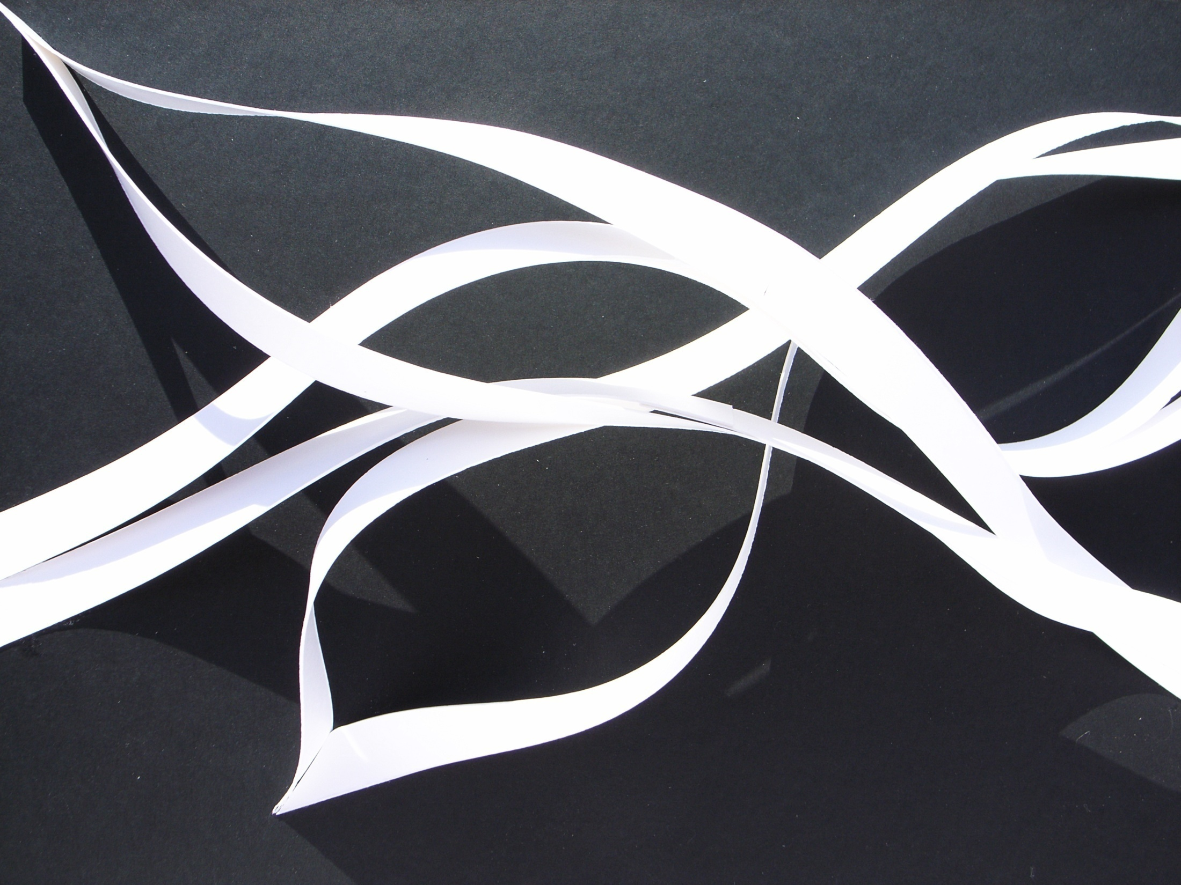
which rules can you use?

Slide 38
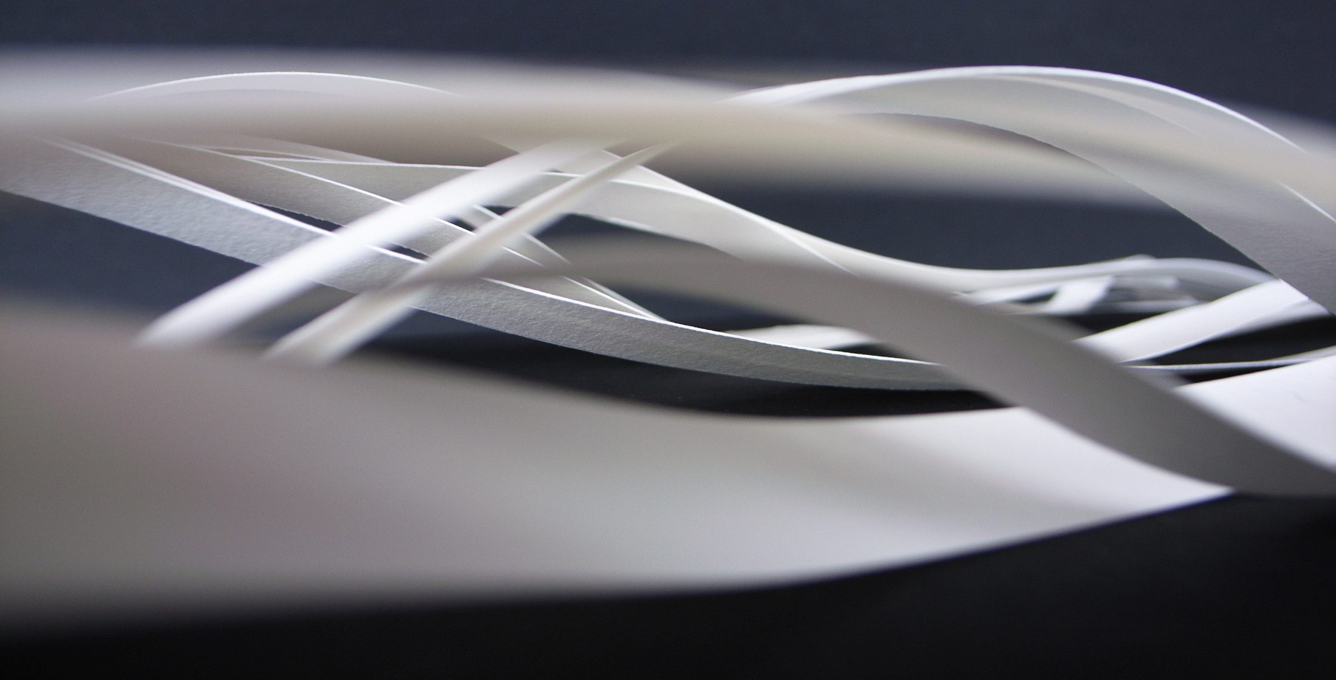
which rules can you use?
make lines, extrude,
solidify

Slide 39
FIND YOUR WAY
Your paper model
bent, twisted, cut
Your 3D model
bend!, twist!, trim!

Slide 40
PROJECTS WITH RHINO

Slide 41
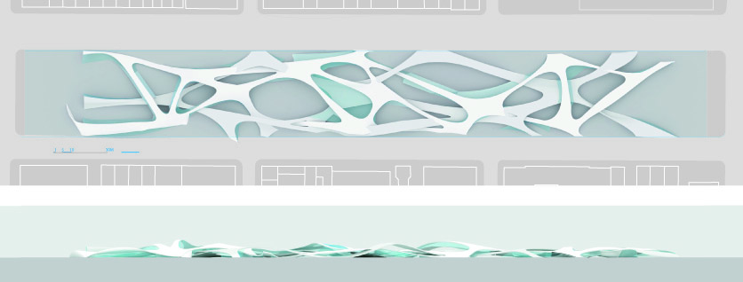
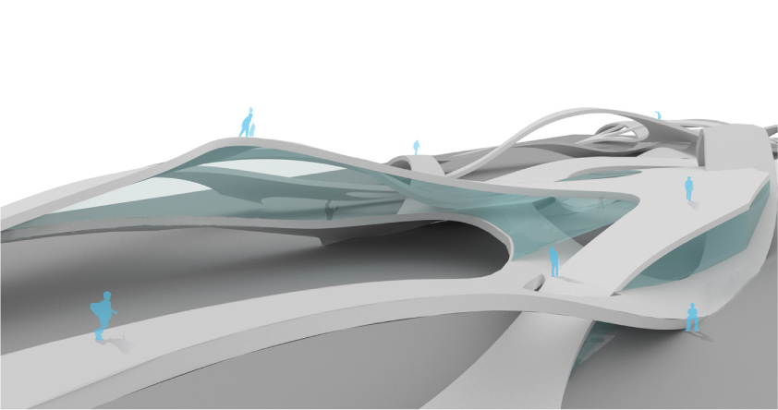
PROJECTS WITH RHINO
RYOKO IKEDA
Social facilitation building in New York
Graduation Project Border Condition 2008

Slide 42
Copyright Giulio Piacentino 2008
All rights reserved. The author may grant a different license in writing. mail@giuliopiacentino.com.

